Slide 1
TOP DOWN SPLAY TREES, AA TREES, AND TREAPS
TEAM 10

Slide 2
MEMBERS OF OUR TEAM
ROHIT KUMAR DAS
KSYBSCIT 050
MRUDAL PATEL
KSYBSCIT 043
HARSHAL KHADE
KSYBSCIT 018
KUMAR MANISK
KSYBSCIT 029

Slide 3
Table of contents
Introduction
Top down splay tree
Operation
Splay tree Algorithm
AA trees
AA trees Algorithm
Treaps

Slide 4
Introduction
What is Splay Trees :
Splay trees are the self-balancing or self-adjusted binary search trees
It has the same properties as the binary tree
The Objective of Splay Tree is to bring the most commonly used element to the root!
Splaying is when you move a node from it’s position all the way to the root by as many “rotations” as needed
Top-down splay tree:
performs rotations on the initial access path. Thus a top-down splay tree node does not need a parent link. The splay operation finishes as soon as the search does. That means the overhead for operations of a top-down splay tree is of a relatively small amount.
Top-down: you first search and at another iteration you rotate

Slide 5
Splay tree terminology
Let X be a non-root node , has at least 1 ancestor
Let P be its parent mode
Let G be its grandparent node(if it exists)
Consider a path from G to X:
Each time we go left ,we say that we “ZIG”
Each time we go right ,we say that we “ZAG”
There are 6 Possible cases:

Slide 6
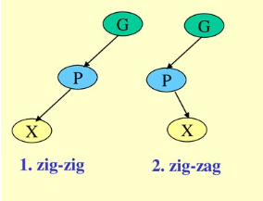
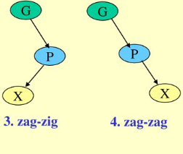
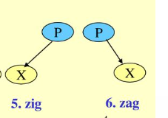

Slide 7
Splay tree operation
When node X is accessed ,apply one of Six rotation operations:
Single Rotation(X has a P but no G):
zig,
zag
Double Rotation(X has both a P and a G):
zig-zig ,
zig-zag ,
zag-zig ,
zag-zag.

Slide 8
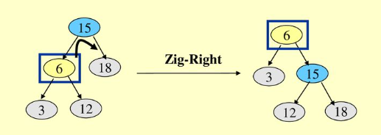
1.Splay tree :Zig operation
“ Zig” is just a single rotation as in an AVL tree suppose 6 was the node that was accessed(e.g. using search)
“ Zig- Right” moves 6 to the root
Can access 6 faster next time

Slide 9
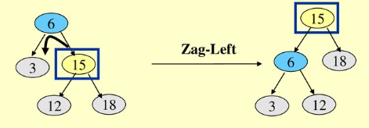
2.Splay tree :ZAg operation
“ Zag” is just a single rotation as in an AVL tree suppose 15 was the node that was accessed(e.g. using search)
“ Zig- left” moves 15 to the root
Can access 15 faster next time

Slide 10
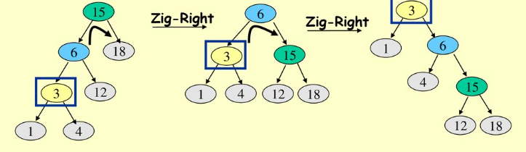
3.Splay tree :Zig-zig operation
“ Zig-Zig” is consist of two single rotation of same type
Suppose 3 was the node that was accessed( e. g. using search
Due to“ Zig- Zig” splaying 3 has bubbled to the top!
Note : Parent-Grandparent is rotated first

Slide 11
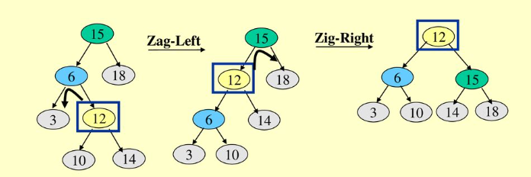
4.Splay tree :Zig-zAg operation
“ Zig-Zag” is consist of two rotation of opposite type
Suppose 12 was the node that was accessed( e. g. using search
Due to“ Zig- Zag” splaying 12 has bubbled to the top!
Note : first left rotation then a right rotation

Slide 12
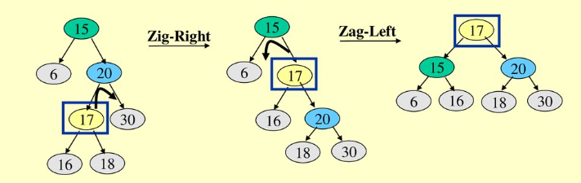
5.Splay tree : ZAg-zig operation
“ Zig-Zig” is consist of two rotation of opposite type
Suppose 17 was the node that was accessed( e. g. using search
Due to“ Zag- Zig” splaying 17 has bubbled to the top!
Note : Right rotation first then right left rotation

Slide 13
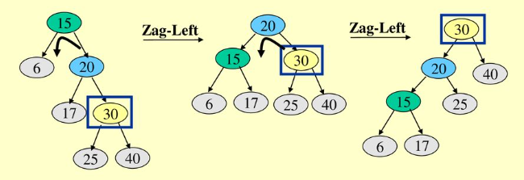
6.Splay tree :Zag- zAg operation
“ Zag-Zag” is consist of two single rotation of same type
Suppose 30 was the node that was accessed( e. g. using search
Due to“ Zag- Zag” splaying 30 has bubbled to the top!
Note : Parent-Grandparent is rotated first

Slide 14
Algorithm for Insertion operation
Insert(T, n)
temp= T_root
y=NULL
while(temp!=NULL)
y=temp
if(n->data <temp->data)
temp=temp->left
else
temp=temp->right
n.parent= y
if(y==NULL)
T_root = n
else if (n->data < y->data)
y->left = n
else
y->right = n
Splay(T, n)

Slide 15
Algorithm for Splaying operation
Splay(T, N)
while(n->parent !=Null)
if(n->parent==T->root)
if(n==n->parent->left)
right_rotation(T, n->parent)
else
left_rotation(T, n->parent)
else
p= n->parent
g = p->parent
if(n=n->parent->left && p=p->parent->left)
right.rotation(T, g), right.rotation(T, p)
else if(n=n->parent->right && p=p->parent->right)
left.rotation(T, g), left.rotation(T, p)
else if(n=n->parent->left && p=p->parent->right)
right.rotation(T, p), left.rotation(T, g)
else
left.rotation(T, p), right.rotation(T, g)
Implementation of right.rotation(T, x)
right.rotation(T, x)
y= x->left
x->left=y->right
y->right=x
return y
In the above implementation, x is the node on which the rotation is performed, whereas y is the left child of the node x.
Implementation of left.rotation(T, x)
left.rotation(T, x)
y=x->right
x->right = y->left
y->left = x
return y

Slide 16
Algorithm of Delete operation
If(root==NULL)
return NULL
Splay(root, data)
If data!= root->data
Element is not present
If root->left==NULL
root=root->right
else
temp=root
Splay(root->left, data)
root1->right=root->right
free(temp)
return root

Slide 17
Advantages and Disadvantages of Splay tree
Advantage:
In the splay tree, we do not need to store the extra information
is the fastest type of Binary Search tree for various practical applications. It is used in Windows NT and GCC compilers.
Disadvantage:
The major drawback of the splay tree would be that trees are not strictly balanced, i.e., they are roughly balanced. Sometimes the splay trees are linear, so it will take O(n) time complexity.

Slide 18
What is an AA tree?
An AA tree, also known as an Arne Andersson tree, is a type of self-balancing binary search tree. It is named after its inventor, Arne Andersson, and is specifically designed to be efficient and easy to implement. The AA tree uses a set of rules to maintain balance
AA trees are similar to red-black trees in that they are both self-balancing binary search trees, but AA trees use a different set of rules and operations to maintain balance.
They are particularly efficient for operations such as insertion, deletion, and traversal due to their

Slide 19
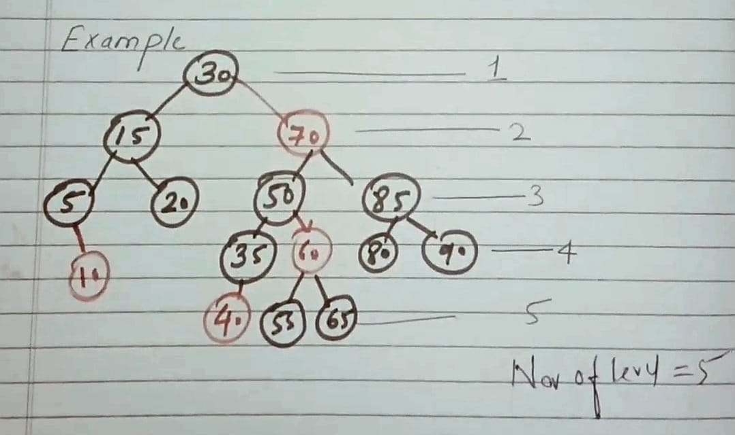
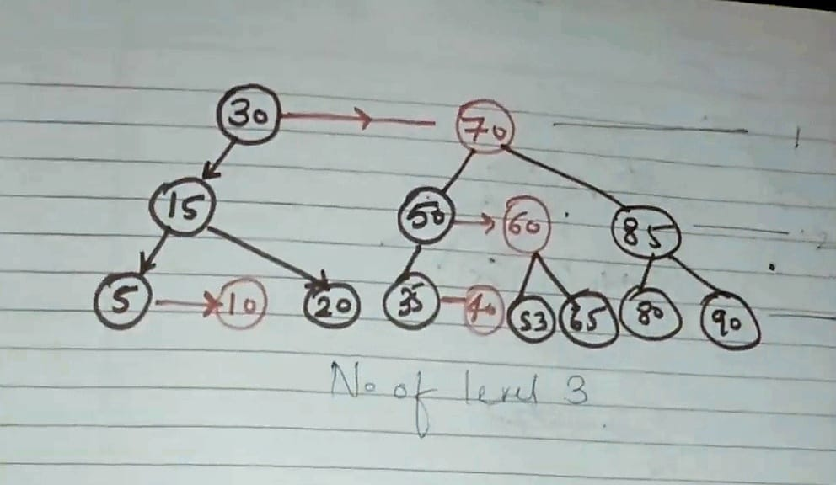
Rules:
1)Every node can be either red or black
2)There are no adjacent red node
3)every path from root to null node has same no of black node
4)Red node is indicated by Horizontal line
5)left node cannot be red

Slide 20
Algorithm of Insertion in AA tree
insert(Link &root, Node &add){
if (root == NULL) // have found where to insert y
root = add;
else if (add->key < root->key) // <= if duplicate ok
insert(root->left, add);
else if (add->key > root->key)
insert(root->right, add); // else handle duplicate if not ok
// do skew and split at each level
skew(root);
split(root);}

Slide 21
Algorithm of Deletion in AA tree
if(root->left->level < root->level -1 || root->right->level < root->level -1)
{
if(root->right->level > --root->level)
root->right->level = root->level
skew(root)
skew(root->right)
skew(root->right->right)
split(root)
split(root->right)
}

Slide 22
Treap
Treap is basically a combination of binary search tree (BST) and Heap.
Every node of Treap maintains two values. 1) Key Follows standard BST ordering (left is smaller and right is greater) 2) Priority Randomly assigned value that follows Max-Heap property.

Slide 23
EXAMPLE OF TREAPS
G
15
D
8
L
10
A
2
F
5
T
6

Slide 24
INSERTION IN TREAPS
1)Insert via BST insert algorithm
2)Use AVL rotation to bubble up to fix heap
Example : Insert (U,15)
S
20
C
8
V
11

Slide 25
S
20
S
20
C
8
V
11
C
8
U
15
U
15
V
11

Slide 26
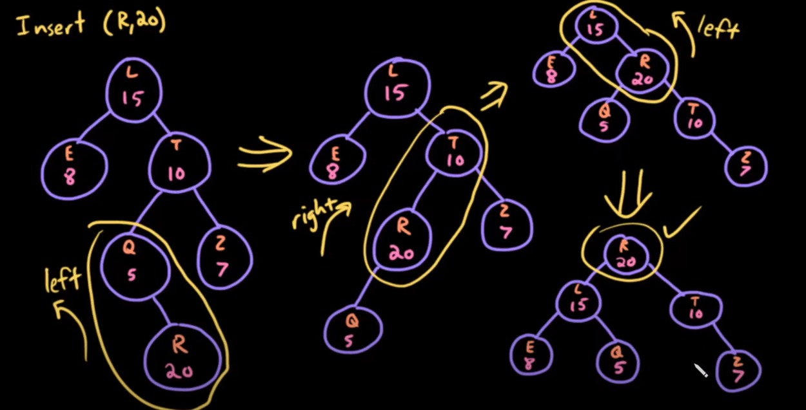

Slide 27
10
8
DELETION IN TREAPS
7
7
40
6
1) If node is a leaf, delete it. 2) If node has one child NULL and other as non-NULL,
replace node with the non-empty child. 3) If node has both children as non-NULL,
find max of left and right children.
a) If priority of right child is greater,
perform left rotation at node
b) If priority of left child is greater,
perform right rotation at node.
20
2
50
5
30
1
60
4

Slide 28
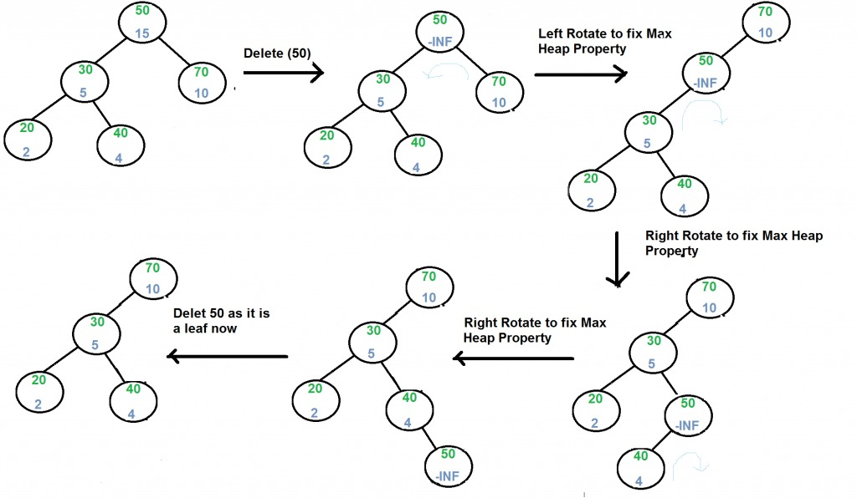

Slide 29
thanks!

